Slide 1
Conditionals
Overview
In this lesson, students will learn to use conditional statements to program logical decisions in Python.
Duration 120 minutes
Learning Objectives
In this lesson, students will:
Define conditional statements in Python to create logic-driven programs.
Use logical operators to enhance conditional statements.

Slide 2
Pre-Class Materials and Preparation
For remote classrooms: Virtual breakout rooms and Slack may be needed to facilitate the partner exercise and discussions. As you plan for your lesson:
Consider how you’ll create pairs for the partner exercise (randomly, or with pre-assigned partners).
Determine how (if at all) exercise timing may need to be adjusted.
For helpful tips, keep an eye out for the For remote classrooms tag in the speaker notes.
Prepare screenshots and answers to exercises in advance so that they can be easily shared in Slack during your lecture.
A note on timing: This lesson allows for a particularly long practice time, so if students are still struggling with lists or dictionaries from Lesson 2, feel free to review those before beginning with the new material.

Slide 3
Pre-Class Materials and Preparation (Cont.)
Pre-Work Review: Many of the concepts covered in this class will recap what students learned in the pre-work; in particular, these myGA lessons:
Control Flow in Python
We recommend reviewing the pre-work lessons to understand what students will come to class knowing. Click here to see the study guides for these lessons. You can also view the pre-work materials on myGA.
For review or extension topics, review the notes in the pre-work for recommendations on how to teach the concept. Leverage the discussions, exercises, and knowledge checks to gauge students’ understanding of concepts. You can adjust your approach to the lesson overall based on how students do with these exercises.

Slide 4
Suggested Agenda
Time | Activity
0:00–0:15 | Welcome + Introduction
0:15–0:40 | Comparison Operators
0:40–0:50 | Break
0:50–1:50 | Complex Conditions
1:50–2:00 | Wrapping Up, Q&A, and Exit Ticket Completion

Slide 5
Jupyter Notebook
The exercises referenced in this lesson can be found in the Python Workbooks + Data folder.
Our first few lessons begin by reviewing the notebook, as the same material was covered in the pre-work.
If students feel that they are able to confidently solve the challenges in the workbook, you can quickly skim through the lesson content and have them only complete the challenges.

Slide 6
Conditionals
Notes:
Duration: 15 minutes

Slide 7
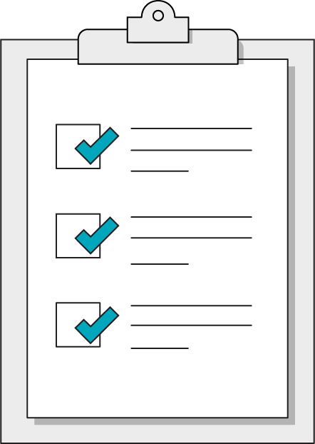
Our Learning Goals
Define conditional statements in Python to create logic-driven programs.
Use logical operators to enhance conditional statements.
Notes:
Purpose: Set expectations for the lesson.
For remote classrooms:
Capture a screenshot of this slide and drop it in the class Slack channel.

Slide 8
What We’ll Practice Today
This class is a blended learning experience. It connects to and reinforces topics that you encountered in the myGA pre-work.
We’re going to return to topics covered in the pre-work and build upon them:
Comparison and logical operators
Conditional statements
Notes:
Purpose: Connect the rest of class to what we’ve already learned in the pre-work.
TALKING POINTS:
We know that you encountered some of what’s in today’s lesson in the pre-work. That’s intentional! We use a blended learning approach that incorporates myGA, assessments, and in-class lessons. They all work together to help you succeed in the course and let us know where you’re coming from.
We don’t want to bore you with stuff you already know, but we also don’t want to skip over really crucial topics. We’ll use discussions and exercises to make sure we’re going at your speed when it comes to familiar topics, as well as the new ones.
The pre-work helps you come into the classroom with a solid, foundational understanding of the basics. We’re going to practice and reinforce those topics and then start to build upon them.

Slide 9
Jupyter Notebook Review
10 minutes
Let’s dive right in and use what we learned in the pre-work! We want to understand where you are in your learning journey so that we can give the best possible experience in class.
Look over the exercises in today's Jupyter Notebook and attempt any that seem immediately doable to you.
Then, rate your confidence level on today's subjects from 1–5.
Notes:
Purpose: Understand how much students have retained from the pre-work lessons.
TEACHING TIPS:
This exercise will help you gauge where students are in terms of how much they retained from the pre-work so that you can appropriately adjust the rest of the lesson/future lessons.
Remind students that we're not asking them to complete all questions immediately. Note that, if they are struggling, we’ll recap how to write each of them in this and the following lesson.
For remote classrooms:
Ask students to rate their confidence in this subject using Slack response emojis 1–5, or a quick anonymous poll. If ALL students feel confident in this subject, feel free to skip through the actual lesson slides and dive right into the exercises in the notebook.

Slide 10
Why Use Conditional Statements?
Conditional logic allows you to create programs that are vastly more complex. Think of the decision-making process of giant flowcharts...
Search Wikipedia
Is it found?
Is there a related term?
No
Yes
No
Yes
Think of another term
Create a new article
Create a redirect
Notes:
Purpose: Review the importance of conditional logic.
TALKING POINTS:
So far, we can write programs that execute in a completely straightforward fashion.
Conditionals allow our programs to start making logical decisions based on specific comparisons of input.
TEACHING TIPS:
This should be a review of what students saw in the pre-work.

Slide 11
Comparison Operators
Conditionals
Notes:
Duration: 25 minutes

Slide 12
Comparison Operators
First, we’ll need comparison operators — a set of operators that give you the ability to compare values and return a Boolean result (true or false).
Comparison Operator | Meaning
> | Greater than
>= | Greater than or equal to
< | Less than
<= | Less than or equal to
== | Equality
!= | Inequality
Notes:
PURPOSE: Review comparison operators.
TALKING POINTS:
A computer can only understand decisions based on these operators. You can also mention to students that “!” means “not” so they’re prepared for future encounters.
Emphasize that these comparisons boil down to a Boolean (true or false). We use them to get to a Boolean result.
TEACHING TIPS:
This should be a review of what students saw in the pre-work.

Slide 13
Conditional Statements
Conditionals use a Boolean value to decide whether or not to do something.
if value_one == value_two:
print("The values are equal!")
print(value_one)
Note the code block defined by indenting lines after a colon. This code block executes if the Boolean provided is true.
Notes:
PURPOSE: Review conditional statements.
TEACHING TIPS:
Emphasize the importance of indentation when it comes to making a conditional work properly and starting a code block.
Any code block is ended by providing a new line that's un-indented, which can be very easy to miss.
This should be a review of what students saw in the pre-work.

Slide 14
else Statements
You will often want to have an else statement immediately after the if statement. This will trigger when the if comparison turns out to be false.
if value_one == value_two:
print("The values are equal!")
else:
print("The values are not equal!")
}
Notes:
PURPOSE: Review conditional statements.
TEACHING TIPS:
Point out the un-indented keyword else.
Again, you're providing blocks of code to a conditional statement — the conditions are on the same level as each other, but each subroutine is indented within the individual condition.
This should be a review of what students saw in the pre-work.

Slide 15
Multiple Conditions
if player_one_score == player_two_score:
print("We have a tie")
elif player_one_score > player_two_score:
print("Player one is victorious!")
else:
print("Player two has triumphed!")
Notes:
PURPOSE: Review multiple conditional statements.
TALKING POINTS:
elif allows for conditional chaining, letting us check many possibilities back to back. Once one comparison evaluates as true, the chain exits.
TEACHING TIPS:
This should be a review of what students saw in the pre-work.

Slide 16

What Happens in This Code?
temperature = 0;
if temperature = 100:
print("Leave your pets indoors for safety")
else:
print("The weather is OK")
Notes:
Purpose: Have students practice reading and reflecting on code.

Slide 17
Careful! Equals Aren’t All Equal...
When you use “=”, that is an assignment operator.
If you try to use “= “instead of “==” in a comparison statement, you will get a syntax error! Be sure to use the equality operator instead:
temperature = 0;
if temperature == 100:
print("Leave your pets indoors for safety")
Notes:
PURPOSE: Reiterate the difference between assignment and evaluation.
TEACHING TIPS:
This should be a review of what students saw in the pre-work.
This is a common gotcha at first.

Slide 18

3.1 Price Conditions
15 minutes
Now that our programs are able to make some decisions, it's time to test out our conditional logic with some price-based questions in Section 3.1 of the workbook.
Notes:
Purpose: Have students practice writing conditional logic.

Slide 19
Logic Operators
Conditionals
Notes:
Duration: 60 minutes

Slide 20
Nesting Conditionals
You can include a conditional inside of another if you want to check multiple conditions:
product_is_good = True;
bank_account = 500;
if product_is_good == True:
if bank_account > 100:
print("Let's buy this product!")
Notes:
Purpose: Review nested conditionals.
TALKING POINTS:
This way, we only check the “bank_account” variable IF our first condition is also met.
However, this can get a bit messy; for this simple situation, it isn't worth having more indented blocks just to add one condition.
So, what's the alternative?
TEACHING TIPS:
This should be a review of what students saw in the pre-work.

Slide 21
Multiple Conditions, One Statement
You can check to see if two conditions are met in one statement with a logic operator:
product_is_good = True;
bank_account = 500;
if product_is_good == True and bank_account > 100:
print("Let's buy this product!")
Notes:
Purpose: Review logic operators
TEACHING TIPS:
This should be a review of what students saw in the pre-work.

Slide 22
Logic Operators
Logic operators allow us to combine multiple conditions together. For very complex conditionals, you can put several conditions in parentheses to evaluate them as a single expression.
Operator | Description
and | Evaluates to true only if all combined values are true.
or | Evaluates to true if any of the combined values are true.
not / ! | Reverses the Boolean result of whatever follows it.
Notes:
PURPOSE: Review logic operators.
TEACHING TIPS:
This should be a review of what students saw in the pre-work.

Slide 23
Pro Tip: Condensing Conditionals
Like we saw in the previous slide, not all conditionals need a comparison statement — especially if the values being tested are already Booleans.
Thus, you will rarely see a comparison with “== true” or “!== false”.
Instead, you can use the following pattern:
if product_is_good and not product_is_too_expensive:
# do something
Notes:
PURPOSE: Introduce how to make conditionals more efficient.
TEACHING TIPS:
Students will start out doing lots of “== True” and such in their conditionals, so the sooner they catch on to the typical pattern and can read more realistic code fluently, the better.

Slide 24
True or False?
15 > 10 and 25 > 30
len("apples") > 5 or len("orange") < 2
( 5 > 10 and 10 > 15 ) or "orange" == "orange"
"bananas" not in ["oranges", "apples"] and len("bananas") < 10
2 + 2 != 4 and 2 + 2 == 5
Notes:
Purpose: Allow students to practice thinking through how logic operators will evaluate.
TEACHING TIPS:
Answers:
1. False
2. True
3. True
4. True
5. False

Slide 25
Making Conditionals Easier
print() is your friend.
Leave yourself messages to figure out what path was taken by a conditional.
If a conditional gives you mysterious results, log the values and data types.
You can also print the Boolean result of a comparison as a sanity check.
Avoid chains that are far too long for one line.
You can nest conditionals within other conditions for complex logic.
Notes:
PURPOSE: Introduce how to validate conditionals.
TALKING POINTS:
If you're checking the value of three different variables, for instance, and have different operations you want to perform for each of the combinations, it's better to nest the conditions instead of having nine extremely long statements in an “if...elif...elif...elif...” situation.

Slide 26
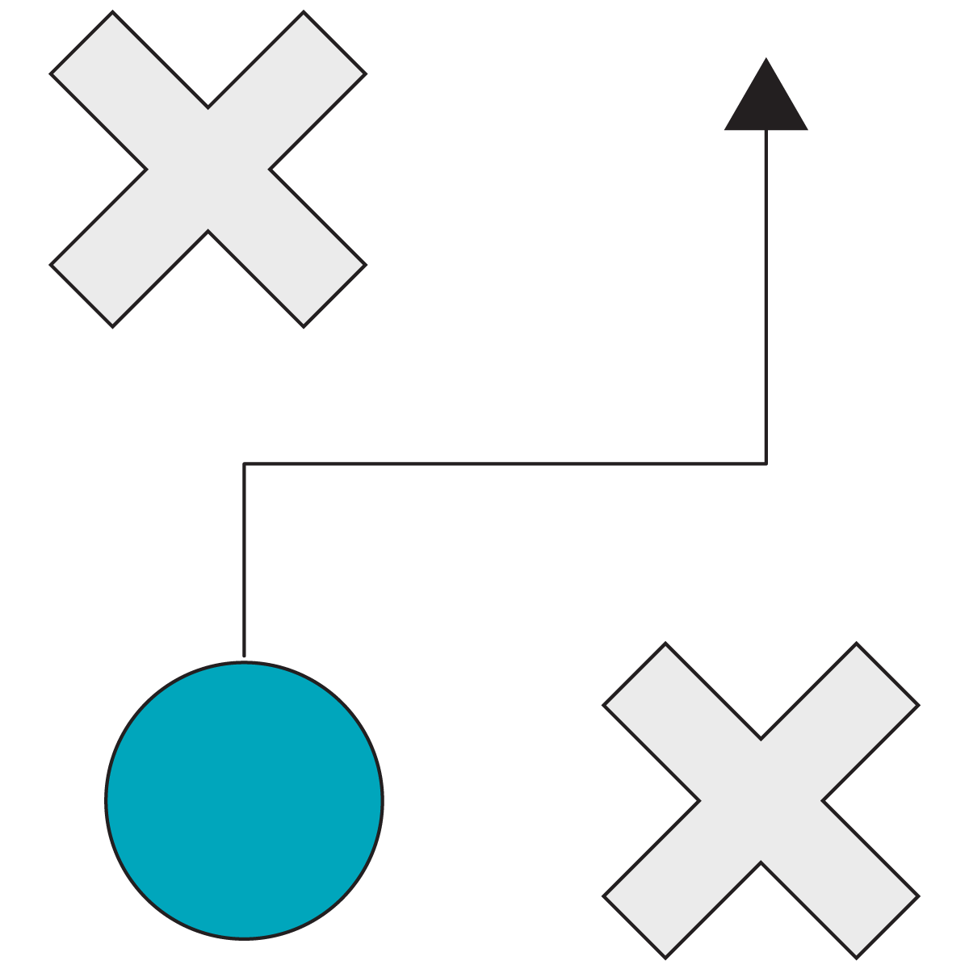
3.2 Complex Conditions
60 minutes
Some complex conditional challenges await you in Section 3.2 of the Jupyter Notebook.
You will need to use our new friends, logical operators, to complete these challenges.
Notes:
PURPOSE: Give students practice with conditionals.
TEACHING TIPS:
These should be some complex challenges for students.
We recommend giving students 10–15 minutes to complete each challenge and then reviewing each individually before moving on to the next, ensuring that no one remains stuck for the entire duration of the exercise.
If students complete these and feel confident, you can incorporate more complex data structures into the challenges for bonus practice (i.e., storing the compared in a dictionary or list instead of as simple variables).
You can use this time to review the previous lesson’s material and reinforce lists and dictionaries before continuing.

Slide 27
Wrapping Up
Conditionals
Notes:
Duration: 10 minutes

Slide 28
Recap
Looking Ahead
In today’s class, we…
Defined conditional statements in Python to create logic-driven programs.
Used logical operators to enhance conditional statements.
On your own:
Ensure that you’ve completed the Python pre-work and pre-work quiz.
Next Class:
Loops
Notes:
Purpose: Recap what was covered in the lesson.

Slide 29

Don’t Forget: Exit Tickets!

